Slide 1
SWIFT LOGISTICS APPLICATION
]

Slide 2
Problem Statement
Customers often lack visibility into the detailed stages of the packing and shipping process, making it challenging for them to track the status of their packages. In the event of a delay or issue within the logistics, customs, cargo, or on-ground processes, customers are left uninformed about the specific stage where their package might be stalled or lost. There is a need to establish a transparent and accessible tracking system that empowers customers with real-time updates, providing clarity on the progression of their packages and alerting them promptly if any disruptions occur, thus enhancing overall customer satisfaction and trust.

Slide 3
Enterprises
We have 4 organizations namely:
  Logistics
  Customs
  Cargo/Shipping
  On-ground Logistics

Slide 4
Logistics
Customer Parcel Collection:
  Role: Logistics employees responsible for collecting parcels from customers.
  Tasks: Gather parcels from customers, ensuring proper documentation and labeling.
Sending to Packaging Organization:
  Role: Logistics employees responsible for transporting parcels to the packaging organization.
  Tasks: Safely transport parcels to the designated packaging organization.
Packaging in the Organization:
  Role: Employees at the packaging organization.
  Tasks: Take care of packaging the parcels securely, ensuring that items are protected during transit.
Returning to Employees:
  Role: Employees of the packaging organization.
  Tasks: Return the properly packaged parcels to logistics employees.

Slide 5
Customs
Handover to Cargo Department:
  Role: Logistics employees.
  Tasks: Hand over the packaged parcels to the cargo department for further processing.
Cargo Validation:
  Role: Cargo employees.
  Tasks: Validate the packages received, ensuring that the correct number and types of parcels are present and in good condition.
Shipment Processing:
  Role: Cargo employees.
  Tasks: Prepare the validated parcels for shipment. This may involve sorting, labeling, and arranging the parcels for transportation to their next destination.
Proceeding with Consequent Steps:
  Role: Cargo employees.
  Tasks: Continue with subsequent steps in the cargo and logistics process, such as loading the parcels onto vehicles, coordinating with transportation services, and ensuring timely delivery to the intended destinations.
  d preparing parcels for transportation to their final destinations.

Slide 6
Cargo/Shipping
Shipment Processing:
  Role: Cargo employees.
  Tasks: Prepare the validated parcels for shipment. This includes sorting, labeling, and assigning a unique shipment ID to each package for tracking purposes.
Tracking and Time Calculation:
  Role: Shipment team.
  Tasks: Assign a unique shipment ID to each package, and record the start time as the moment the package is officially processed within the shipment team. Additionally, track the reach time, marking when the package reaches its destination.

Slide 7
On-ground Logistics
On-Ground Logistics Department:
  Role: On-ground logistics department admin.
  Tasks: Receive packages from the shipment team. Assign packages to on-ground logistics employees for the final leg of the journey.
Assignment to Employees:
  Role: On-ground logistics employees.
  Tasks: Receive assignments from the admin, collect assigned packages, and prepare for the last-mile delivery to customers.
Customer Delivery:
  Role: On-ground logistics employees.
  Tasks: Deliver packages to customers based on assigned routes. Update the system with delivery times and confirm successful deliveries.
Final Administration:
  Role: Administrative staff within the entire logistics process.
  Tasks: Oversee the complete process, manage documentation, handle customer inquiries, and ensure accurate tracking information is maintained.

Slide 8
Roles Included
Customer:
    Role:
    Initiates the shipping process by providing packages for delivery.
    Responsibilities:
    Properly package items.
    Provide accurate documentation and labeling.
    Be available for package collection.
Logistics Admin:
    Role:
    Oversees the entire logistics process.
    Responsibilities:
    Manages documentation and coordination with various departments.
    Assigns tasks to logistics employees.
    Handles customer inquiries and resolves issues.

Slide 9
Roles Included
Logistics Employee:
    Role:
    Involved in the collection and transportation of packages.
    Responsibilities:
    Collects parcels from customers.
    Transports parcels to packaging organizations.
    Coordinates with the cargo department.
Cargo Admin/Shipping
    Role:
    Handles the validation and processing of packages for shipment.
    Responsibilities:
    Validates packages received from logistics.
    Assigns unique shipment IDs and records start and reach times.
    Prepares packages for shipment.

Slide 10
Roles Included
Customs:
    Role:
    Ensures compliance with customs regulations and facilitates the clearance of goods.
    Responsibilities:
    Verifies shipping documents for accuracy and compliance.
    Conducts inspections when necessary.
On-ground Admin:
    Role:
    Manages the on-ground logistics department.
    Responsibilities:
    Receives packages from the shipment team.
    Assigns packages to on-ground logistics employees.
    Coordinates the final leg of the delivery process.

Slide 11
Roles Included
On-ground Employee:
  Role:
  Executes the final leg of the delivery to customers.
  Responsibilities:
  Receives assignments from on-ground admin.
  Collects assigned packages and prepares for delivery.
  Ensures timely and accurate delivery to customers.

Slide 12
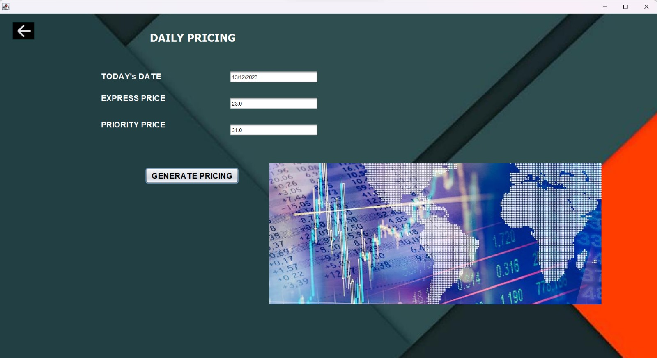
Daily Pricing Updates

Slide 13
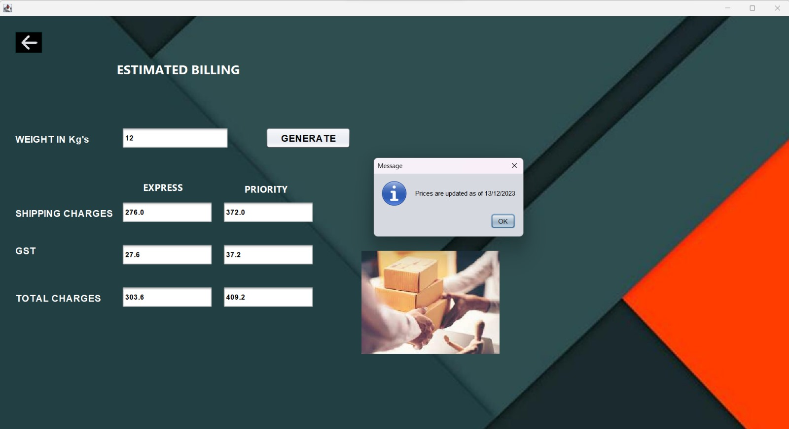
Customer Shipment Cost Estimation

Slide 14
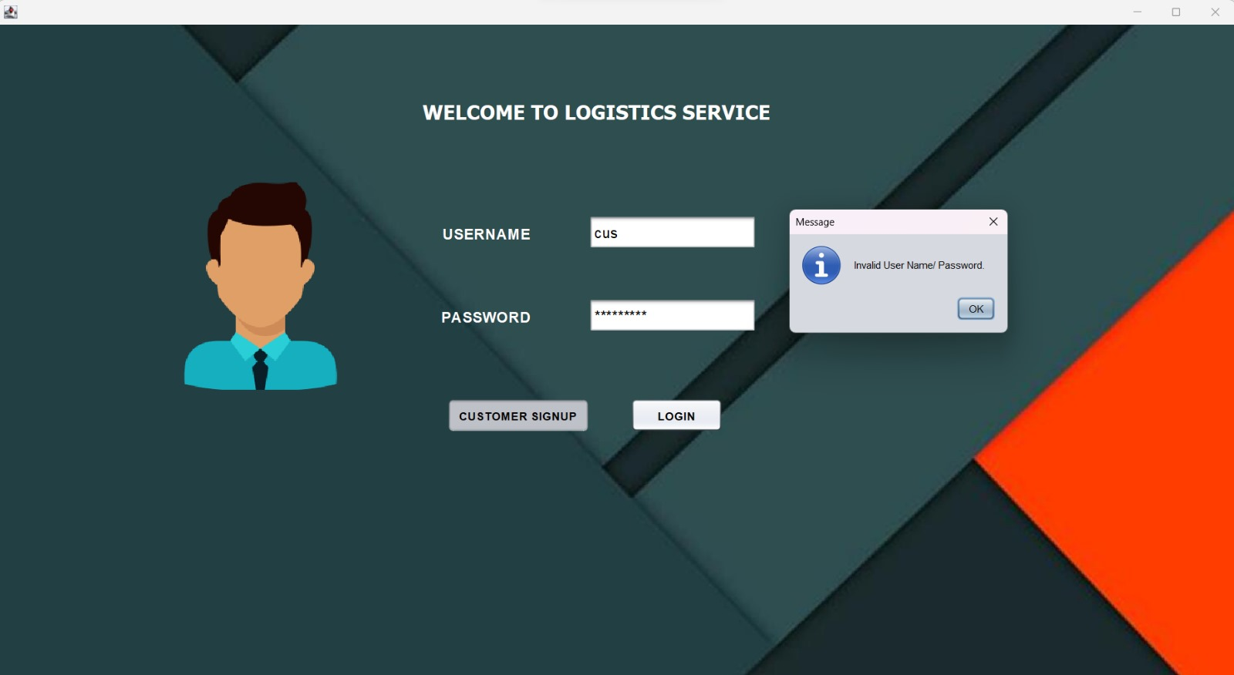
Robust Role Based Authentication

Slide 15

Customer Reports

Slide 16


Slide 17
THANK YOU!!

